Slide 1

Curves:
Andrew Abbott
Randy Lisbona
API
https://data.texas.gov/download/f6mt-vx3q/application%2Fpdf
Data feed
http://tti-i35-data.tamu.edu/data/awam/i35/i35_bluetooth_traveltimes_out.xml

Slide 2
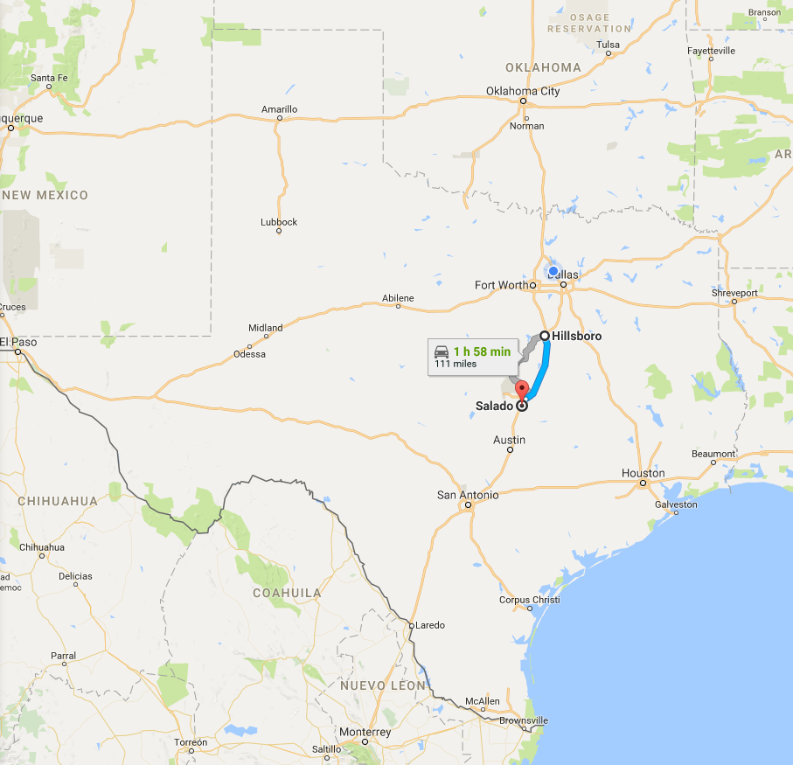
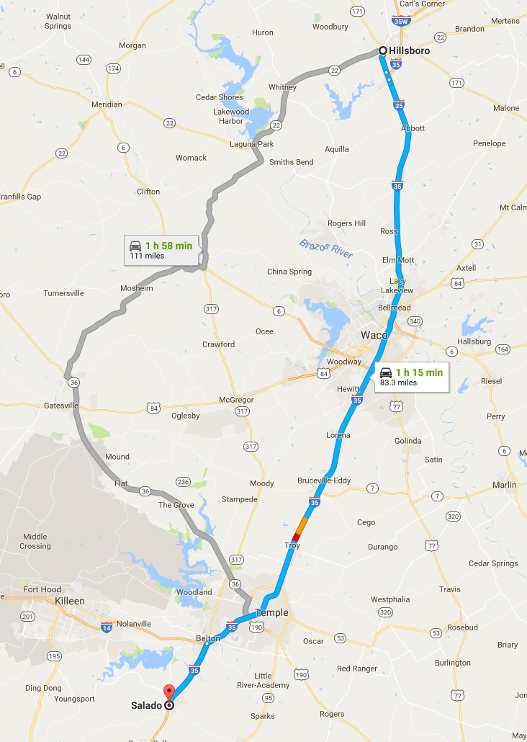
Map of The Great State of Texas
Section of I-35 with traffic sensors

Slide 3
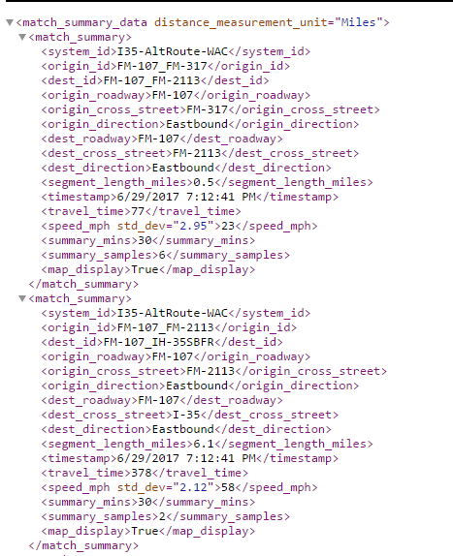
Example XML
Approx. 9,000 records in the data feed
Refresh XML feed, look for first timestamp, decide whether to process the rest of the feed

Slide 4
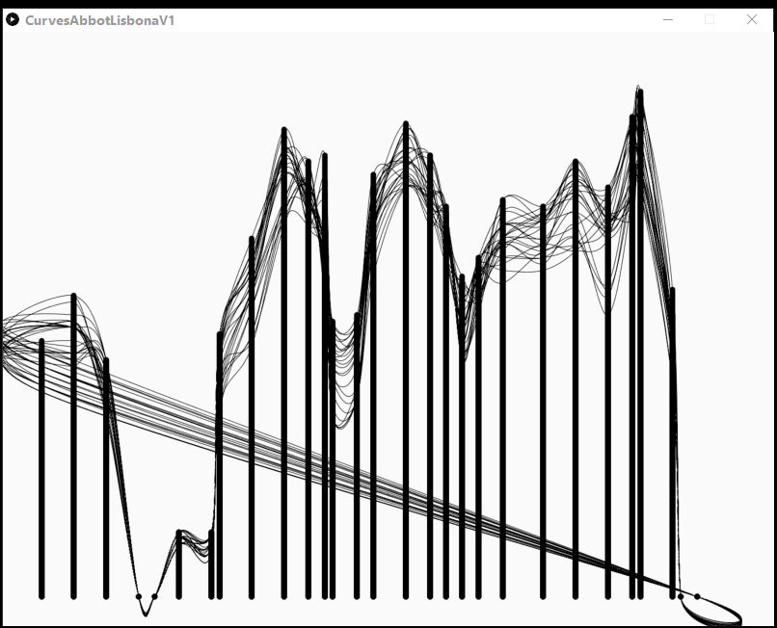
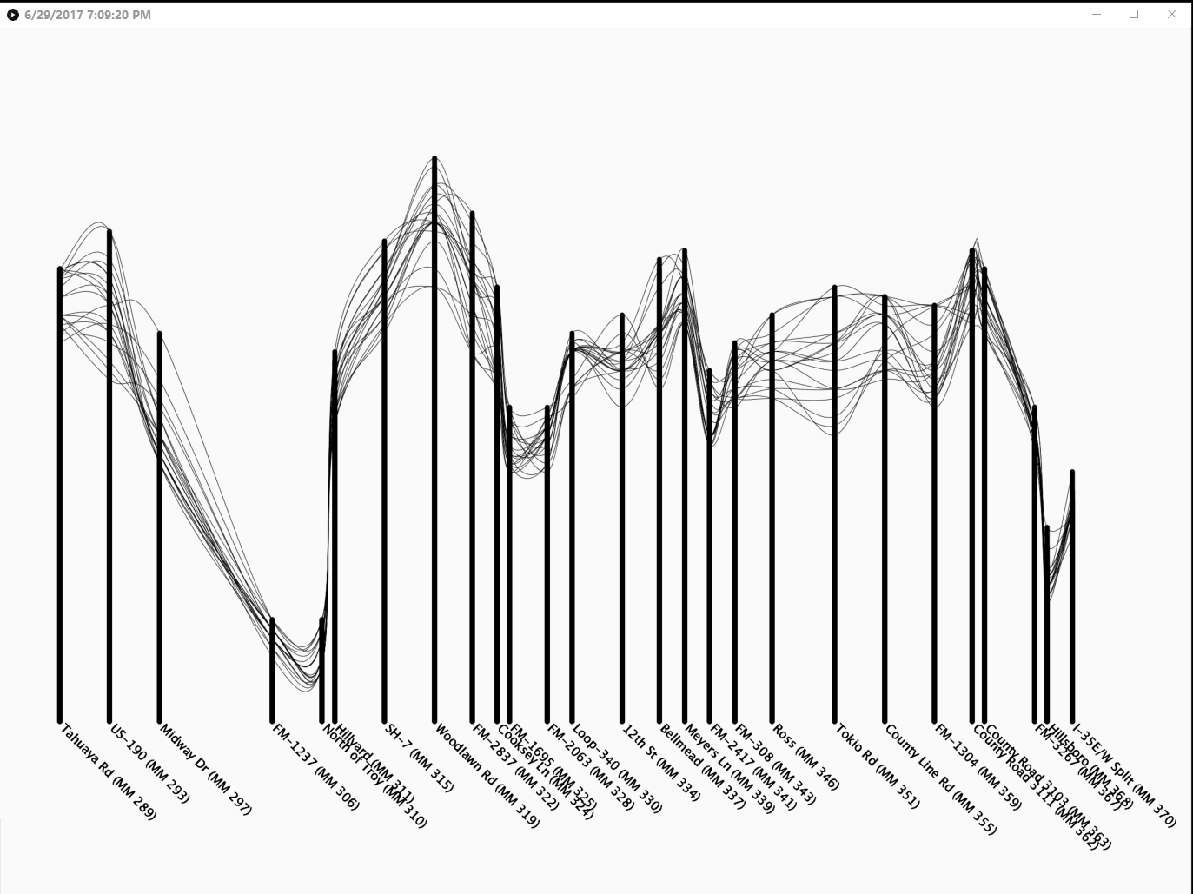
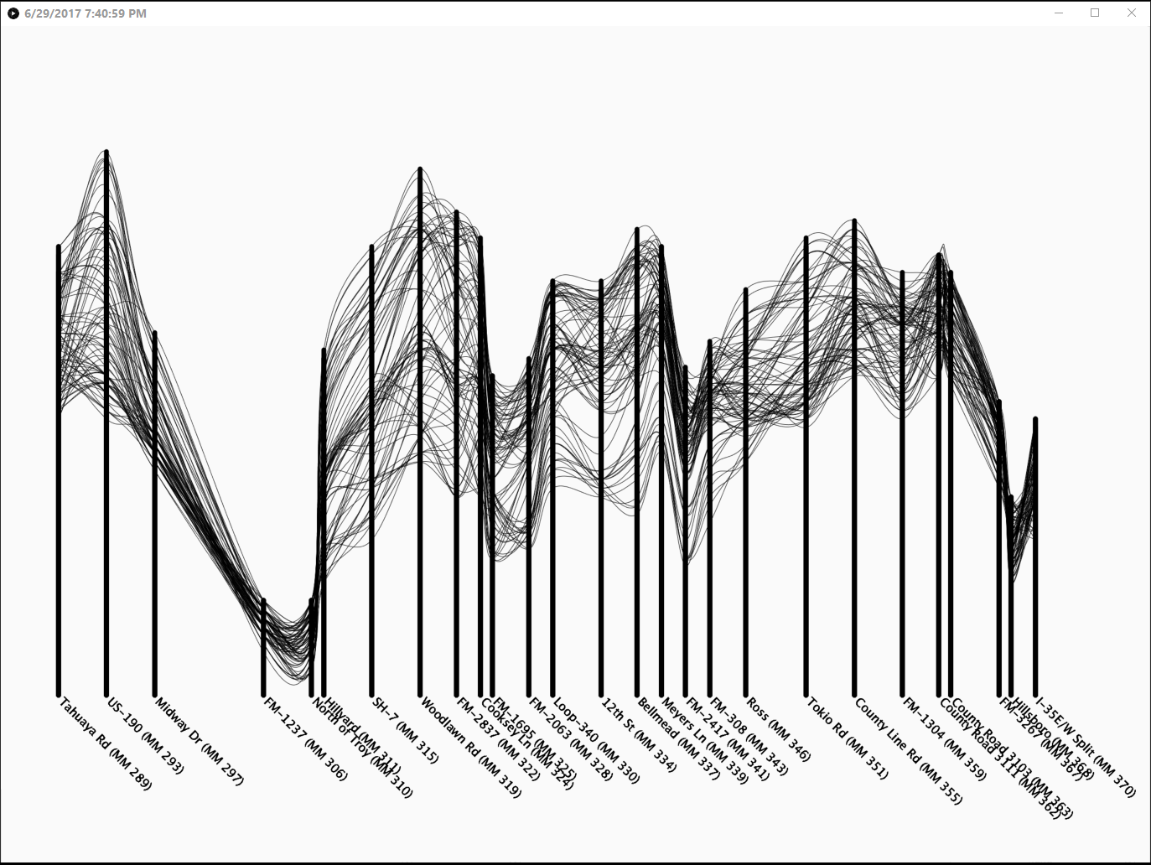
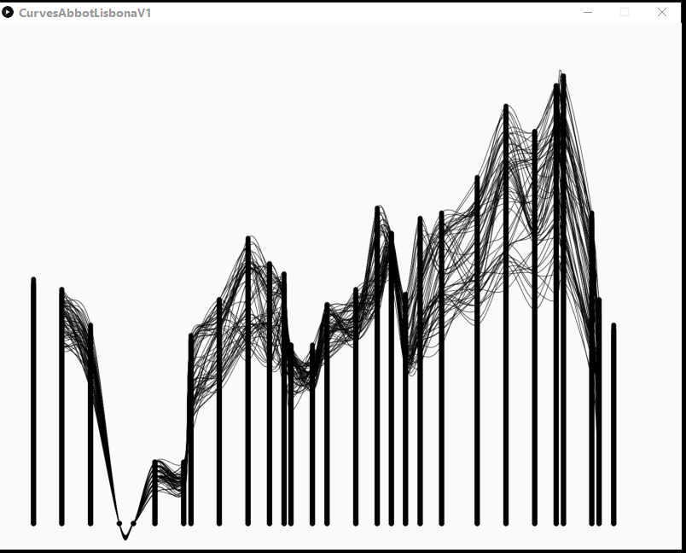
Example output as code evolved

